Slide 1

System Design & Analysis
PHASE FOUR
5.1.2024

Slide 2
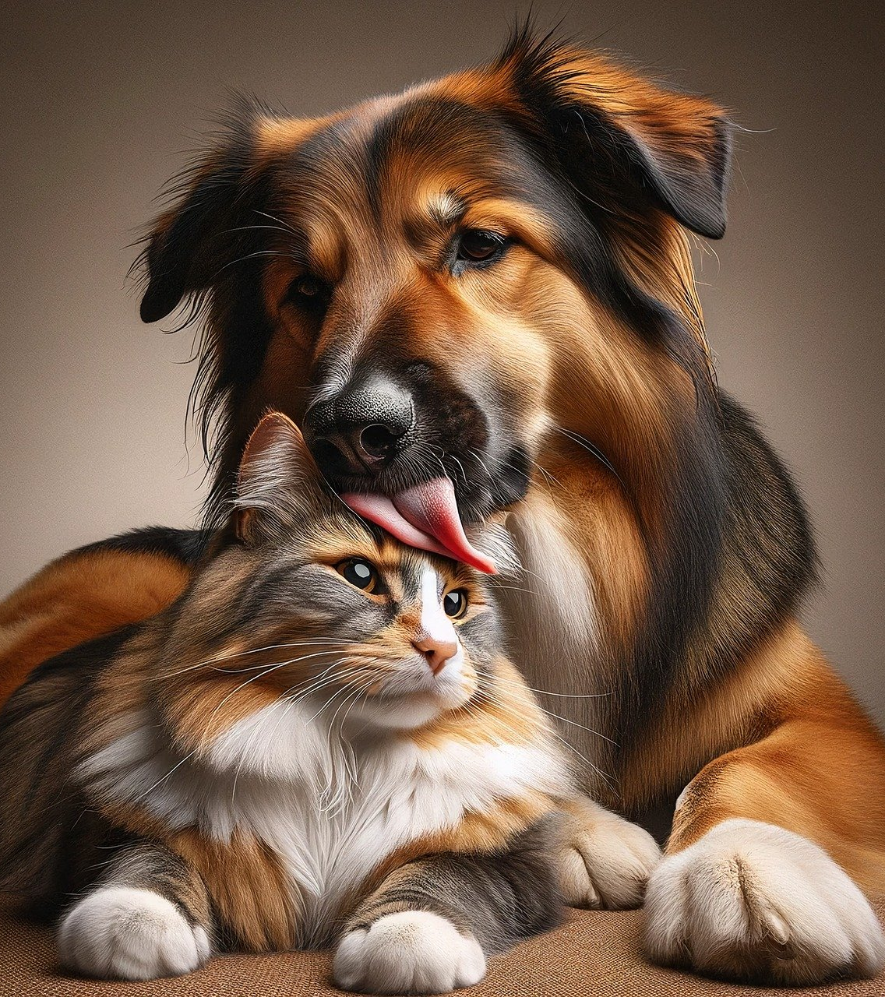
“We’re not to blame for your pet’s bad name”
PET NAMER
Would you like help picking
a name for your pet?
Simply upload a picture and
we’ll recommend a few
different names for you!
*Cats, Dogs, Birds, Hamsters, snakes, and Cows

Slide 3
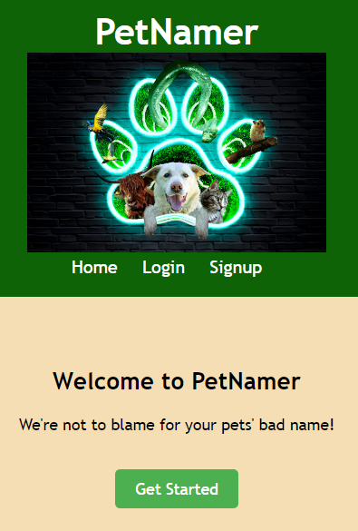
Interface: landing page
When a pet owner IS NOT logged in, this is the home page.
Navigation bar links:
Home (current page)
Login (must already have an account)
Signup (create new account)
Page link:
Get Started (goes to login page)

Slide 4
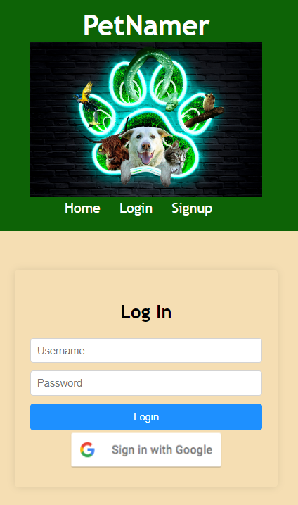
Interface: login page
Navigation bar links:
Home (landing page)
Login (current page, must already have an account)
Signup (create new account)
Page links:
Login (when a pet owner already has an account)
Sign in with Google (a pet owner can use their Google account to log in)

Slide 5
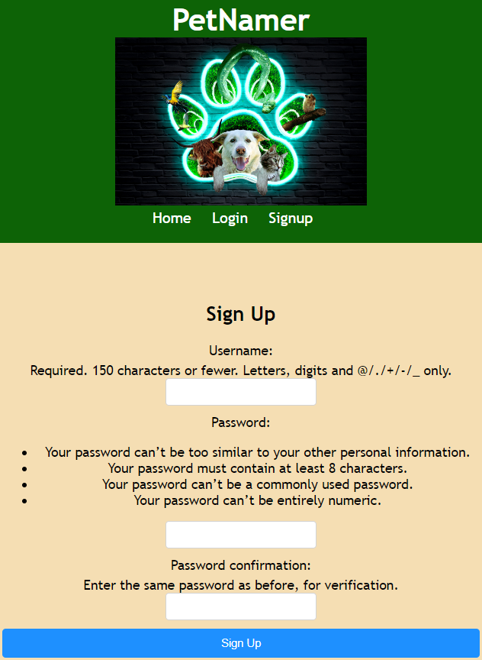
Interface: signup page
Navigation bar links:
Home (landing page)
Login (current page, must already have an account)
Signup (current page)
Page link:
Sign Up (completes account creation, goes to the login screen)

Slide 6
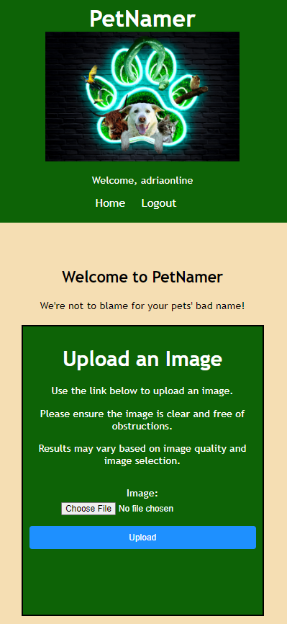
Interface: upload image (home)
When a pet owner IS logged in, this is the home page.
Navigation bar links:
Home (landing page)
Logout (returns to the landing page)
Page links:
Choose File (opens local file system)
Upload (uploads file after one is selected)

Slide 7
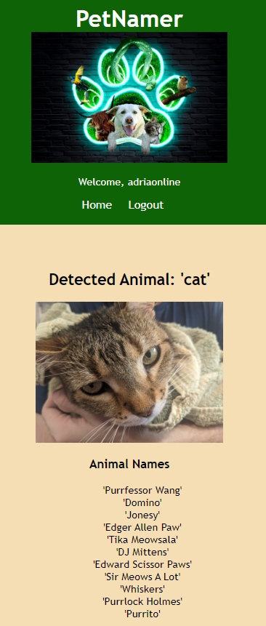
Interface: Pet name suggestions
Navigation bar links:
Home (landing page)
Logout (returns to the landing page)
Page links:
None

Slide 8

Technology: hardware & software
Local Local Host Laptop/Desktop
Local Host Router
VSCode IDE
Django (includes SQL database)
Python 3.11.8
Google Authentication API
Azure Image Recognition AI API

Slide 9
database
The Django framework includes SQL database management accessible through the administrative section of the website. We set up the following animal name databases for the Azure image recognition API to reference:
Cats
Dogs
Birds
Hamsters
Snakes
Cows

Slide 10
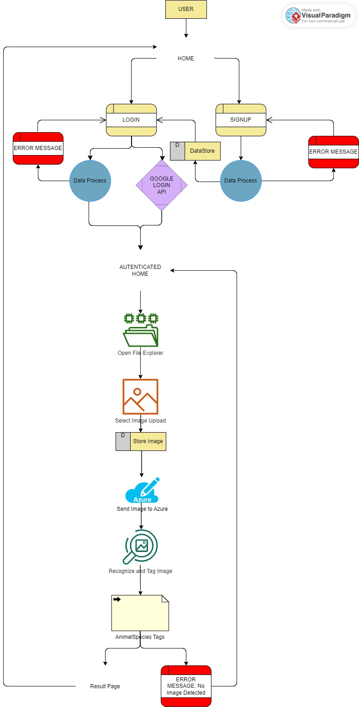
Data flow

Slide 11
LIVE demo
Team 1: Final Presentation

